Slide 1
PRE-DECODER
AND
COLUMN DECODER DESIGN
7
Group Number:
Group Members :
MT25111 Charu Singh
MT25130 Neeti Mishra
MT25157 Vishal Kumar Singh
Course:- Memory Design And Test
Prof.: Dr Anuj Grover

Slide 2
Problem Statement
Requirements :
To design a pre-decoder with the following
Input capacitance <10fF
Output loading is for 512 rows,
Hold time to be negative at FF/1.32/-40,
Setup time to be within 500ps at SS/1.08/125
MEMORY SCRAMBLING:
The memory size is 8192 × 32 bits, so a total of 13 address bits (A12–A0) are required.
The higher address bits (A12–A4) are used for row selection through pre-decoding and post-decoding stages.
The pre-decoding is implemented using three 3:8 decoders, which divide the address bits into groups for efficient row decoding.
The lower address bits (A3–A0) are used for column decoding, corresponding to the MUX16 configuration.

Slide 3
Possible pre-decoding stages
Specification / Stages | 2: 3x8 Decoder 1: 2x4 Decoder 1: 1x2 Decoder | 1: 3x8 Decoder 3: 2x4 Decoder | 1: 3x8 Decoder 2: 2x4 Decoder 2: 1x2 Decoder | 3: 3x8 Decoder
 | 22 output lines | 20 output lines | 20 output lines | 24 output lines
 | Total tapping = 512 | Total tapping = 448 | Total tapping = 476 | Total tapping = 192
Area
Power
3:3x8 decoder configuration is selected as it provides the best trade-off between area and power, achieving minimum power consumption with acceptable area overhead.

Slide 4
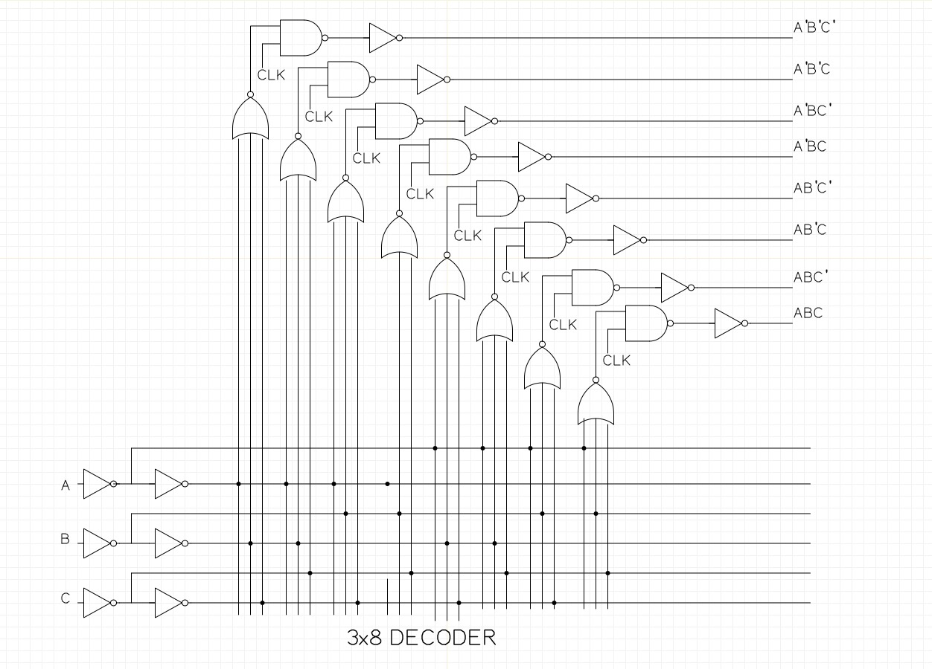
3:8 Pre-Decoder With Inverter Schematic
Sizing Using Logical Effort:
Gates | PMOS | NMOS
A1,A2,A3 | 1.35u | 0.55u
B | 2.03u | 1.5u
C | 5.6u | 1.5u
D | 4.5u | 4.5u
E | 8.0u | 3.4u

Slide 5
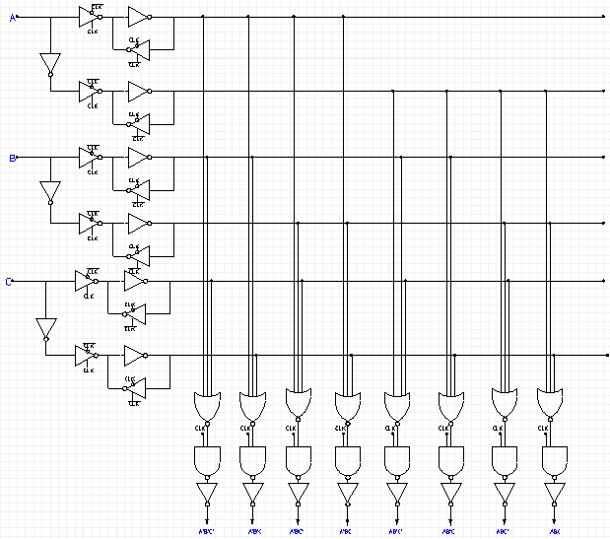
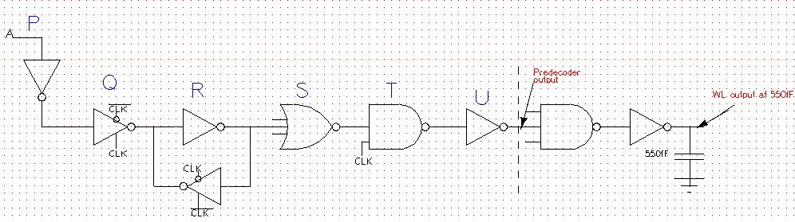
3:8 Pre-Decoder Schematic & Sizing
Sizing Using Logical Effort:
Gates | PMOS | NMOS
P | 0.378u | 0.140u
Q | 0.45u | 0.170u
R | 0.639u | 0.275u
S | 1.169u | 0.167u
T | 1.246u | 1.07u
U | 5.32u | 2.289u

Slide 6
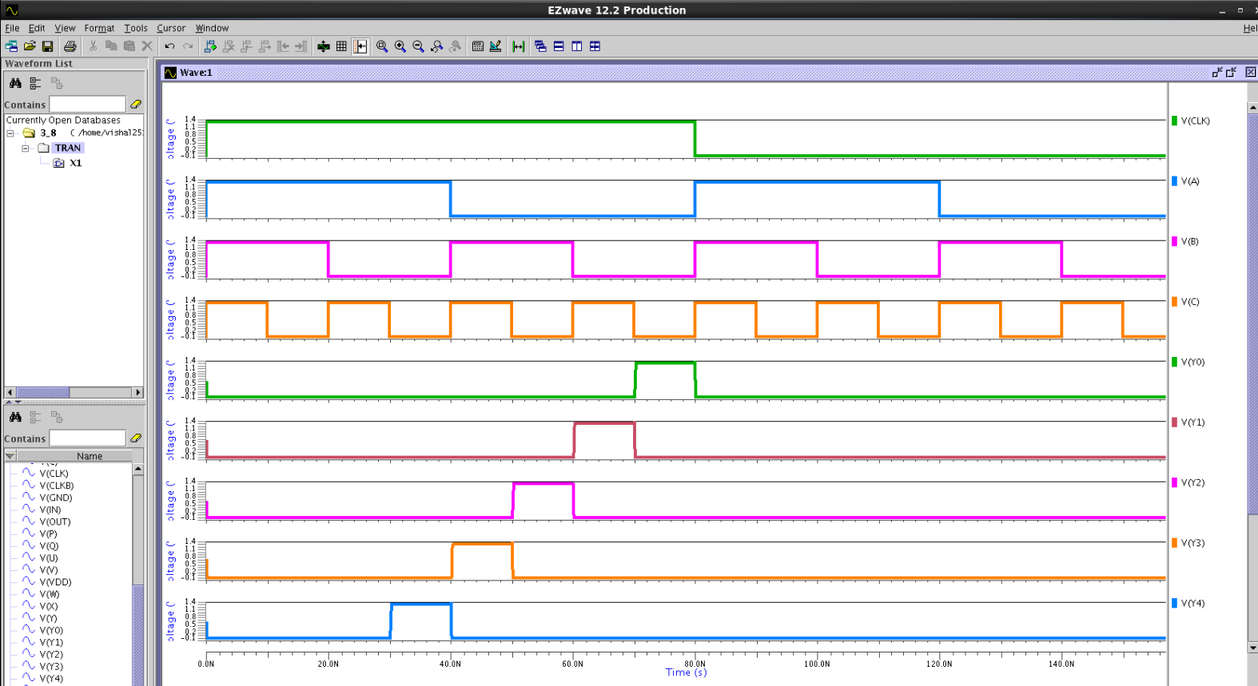
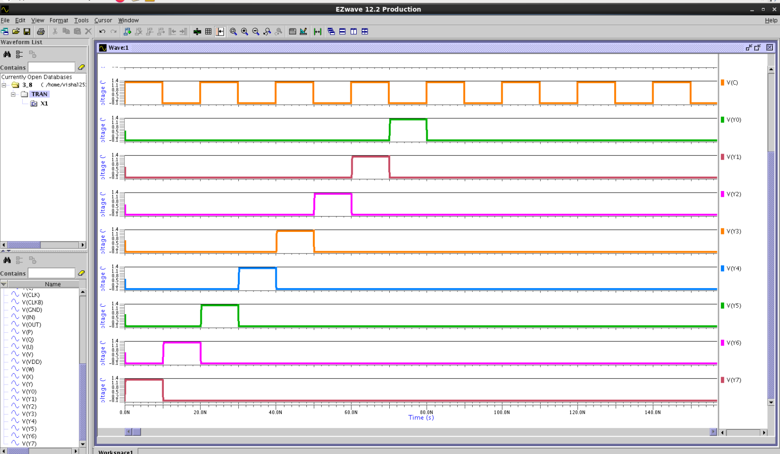
EZ Wave Simulation Results

Slide 7
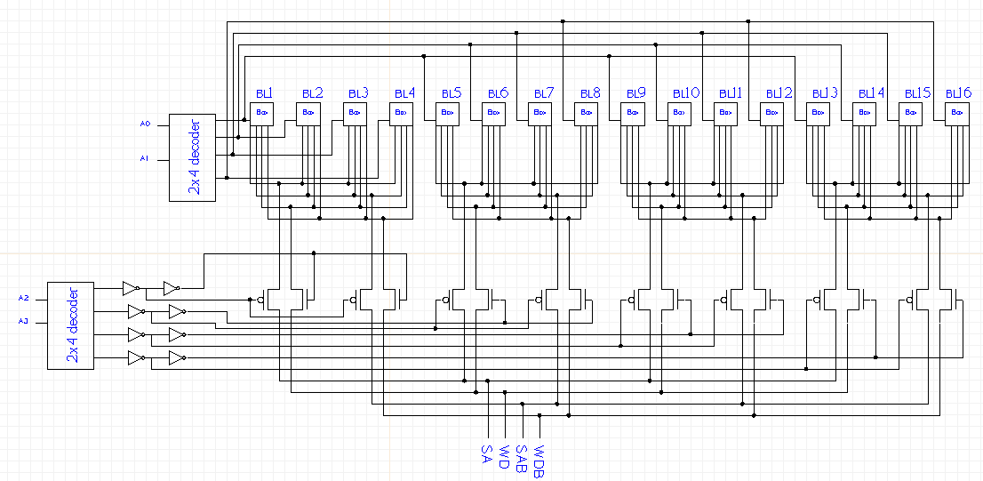
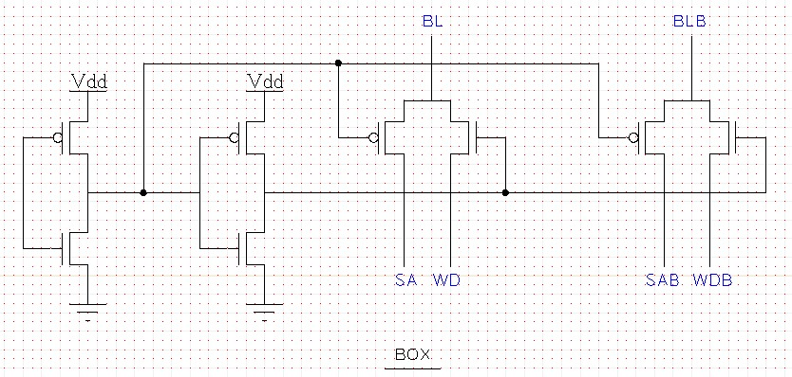
Column Decoder Schematic
BL Selection Box

Slide 8
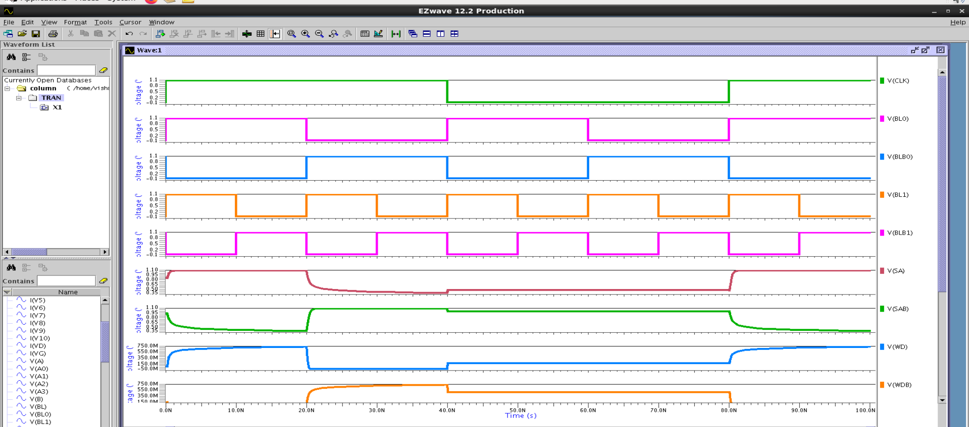
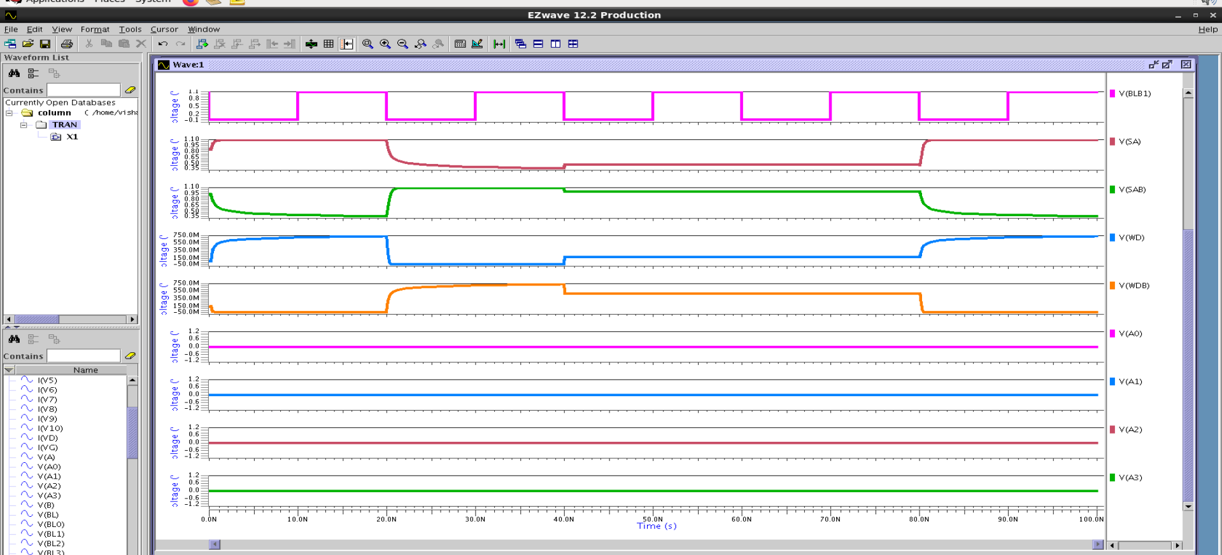
EZ Wave Simulation Results

Slide 9
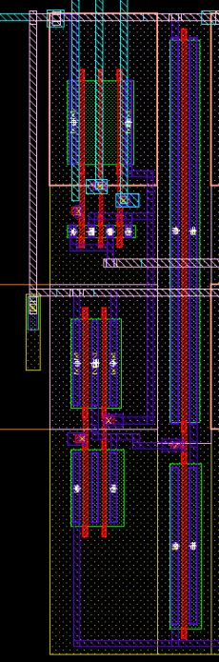
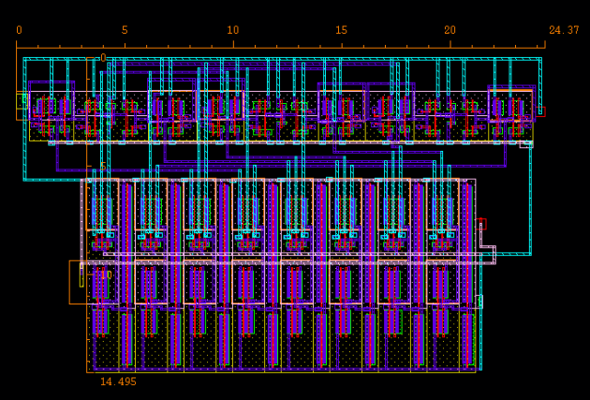
Pre Decoder: 3x8 Decoder Layout
Iteration 1
Area: 14.495*24.37 = 353.24 µm²

Slide 10
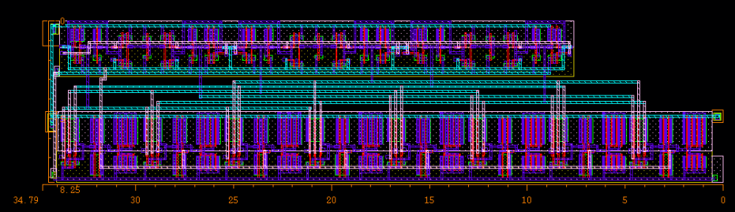
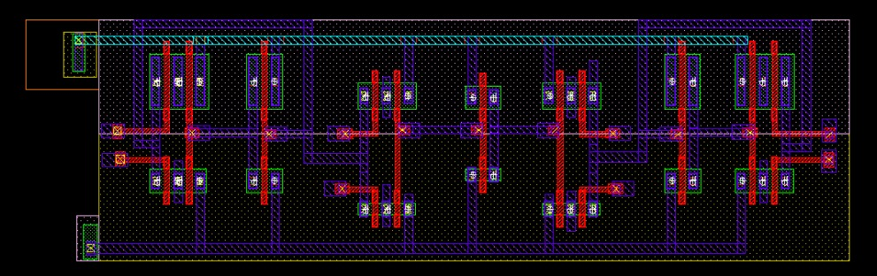
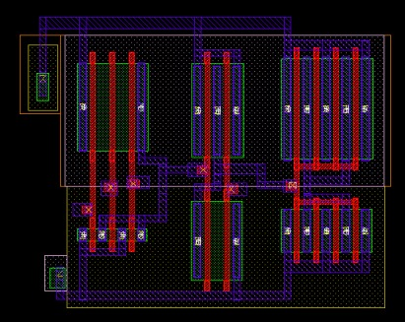
Pre Decoder: 3x8 Decoder Layout
Iteration 2
Area: 34.79*8.25 = 287.01 µm²
Tri State Latch

Slide 11
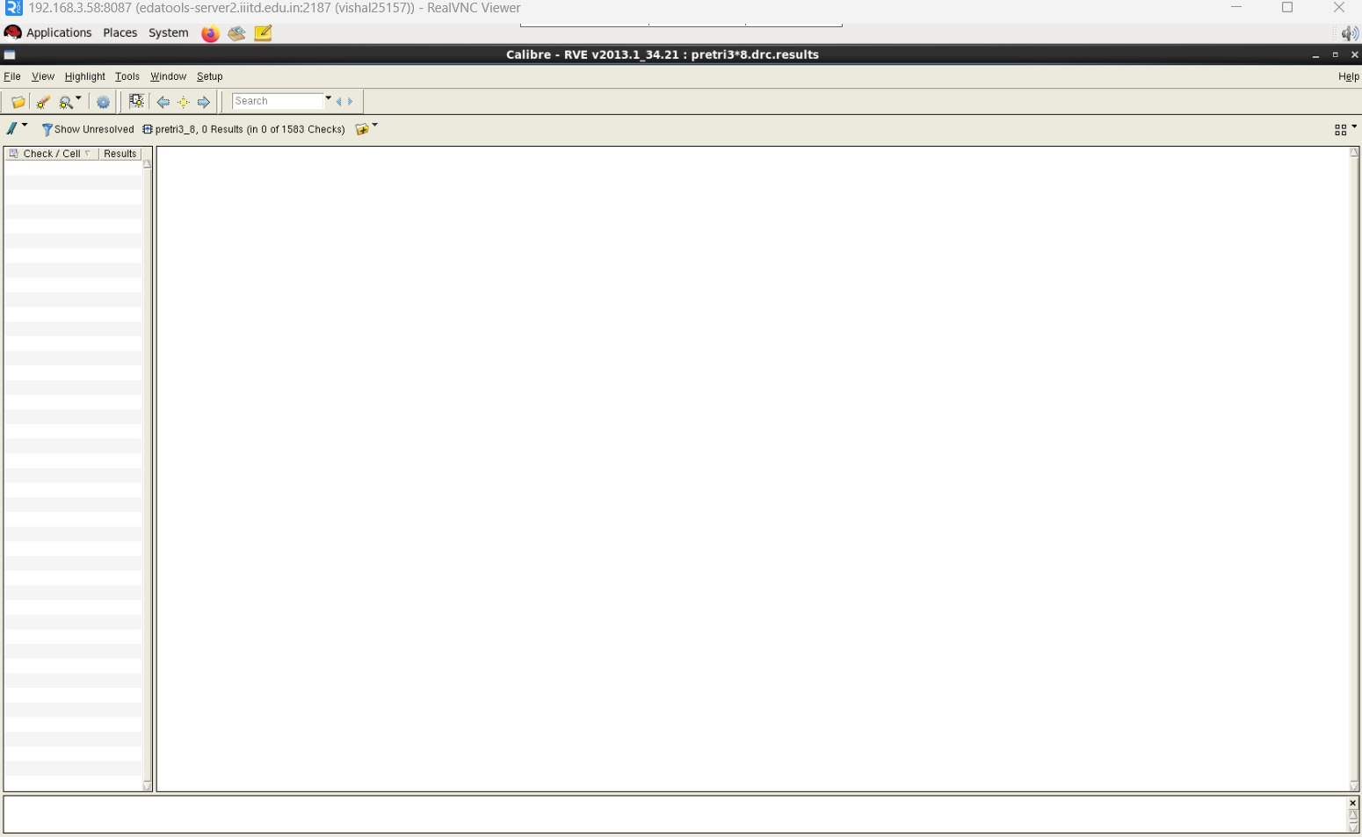
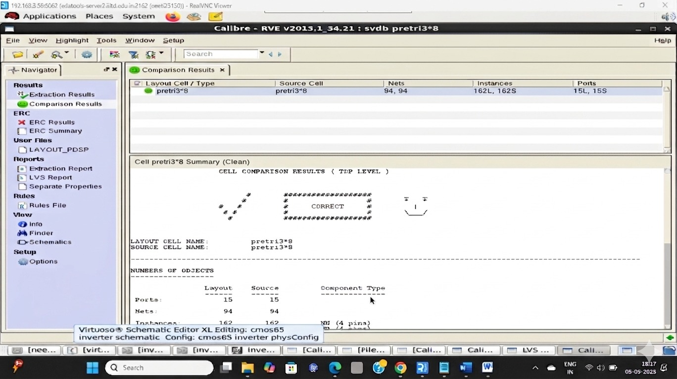
Pre Decoder: 3x8 Decoder Layout
DRC & LVS Clean Report

Slide 12
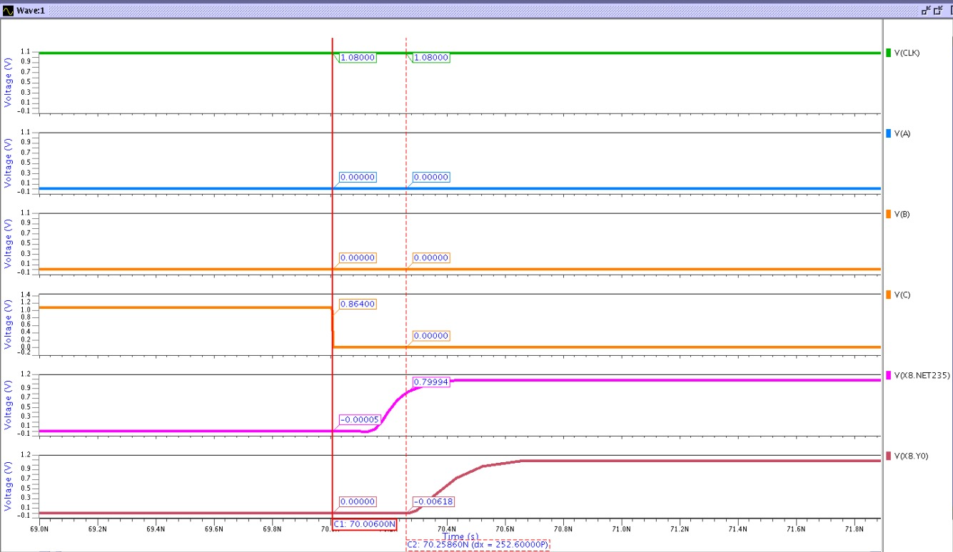
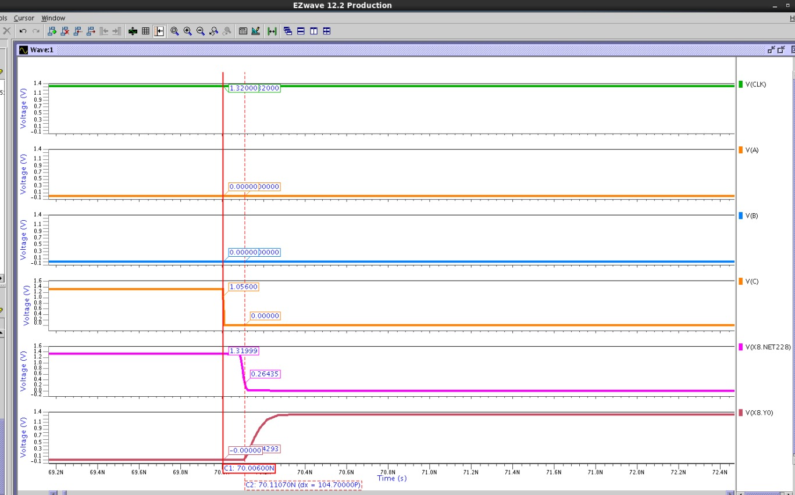
Setup & Hold Time Waveform (3:8)
Waveform For Setup
Waveform For Hold

Slide 13
Setup & Hold Time Results(3:8)
Input(ABC) | Setup Time(ps) | Hold Time (ps)
000 | 199.6 | -61.7
001 | 239.51 | -59.11
010 | 226.6 | -62.7
011 | 264.29 | -87.78
100 | 199.61 | -62.71
101 | 239.2 | -78.93
110 | 198.3 | -61.46
111 | 263.15 | -84.44
Tristate Latch Hold Time
-17.7ps
Delay in CLK w.r.t. External CLK at SS/1.08/125 = 53 ps
Delay in CLK w.r.t. External CLK at FF/1.32/-40 = 42 ps

Slide 14
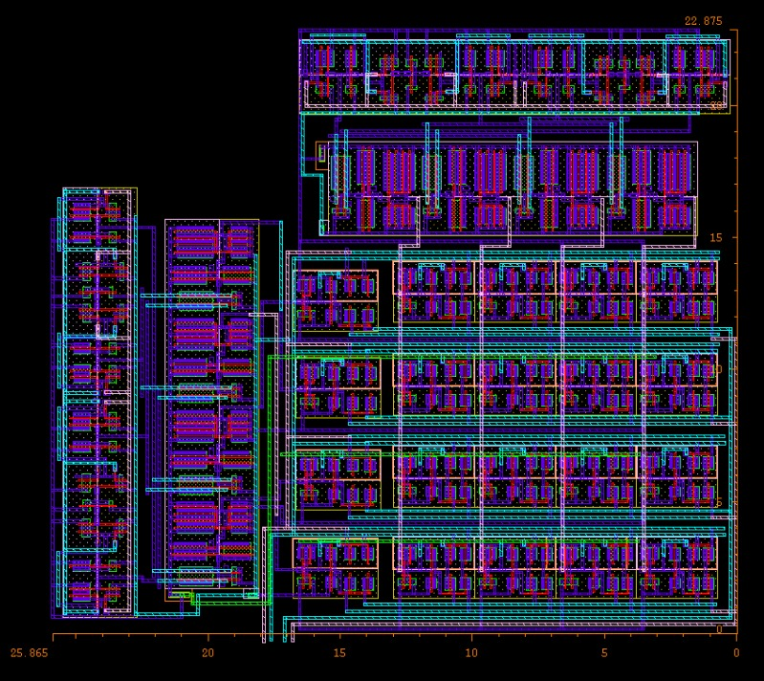
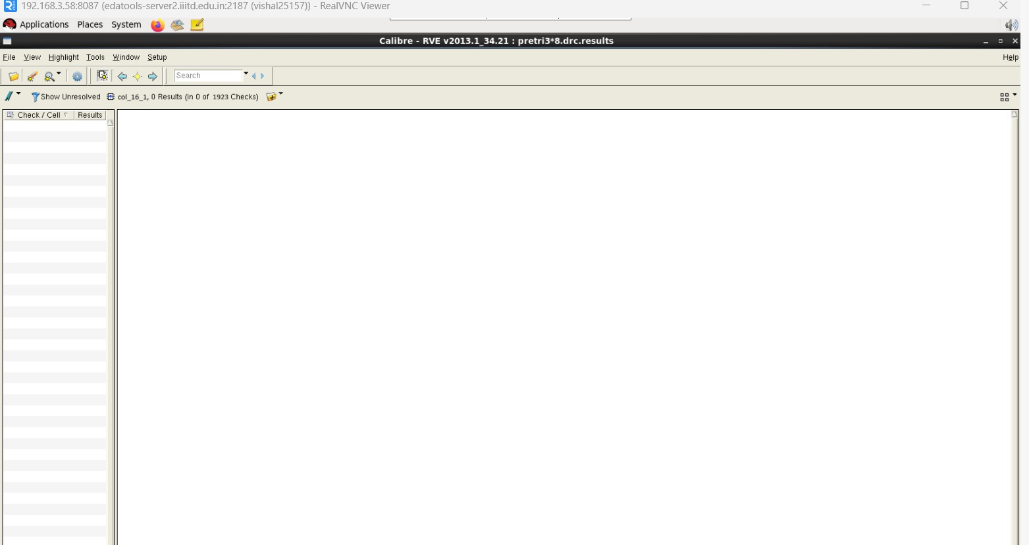
Column Decoder Layout
Area: 25.865*22.875 = 591.661µm²
DRC Report

Slide 15
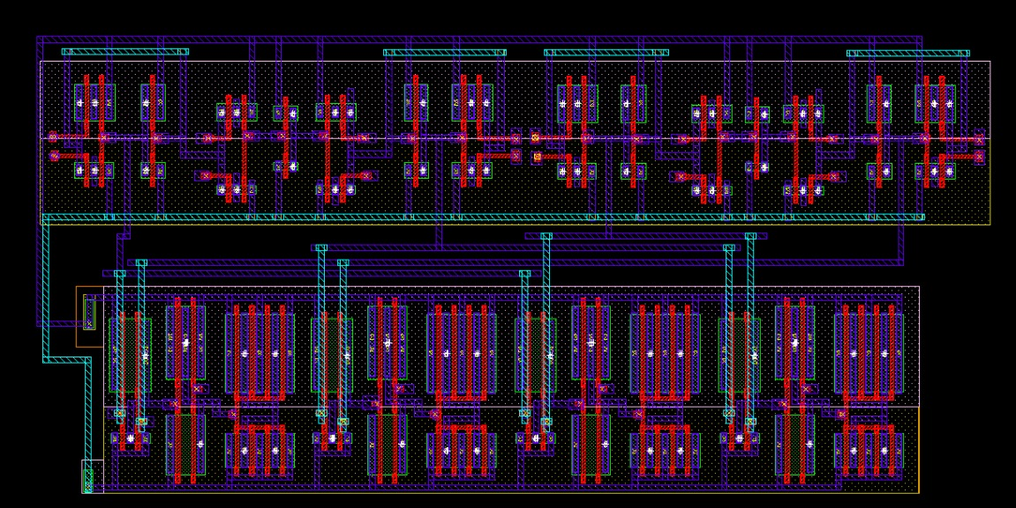
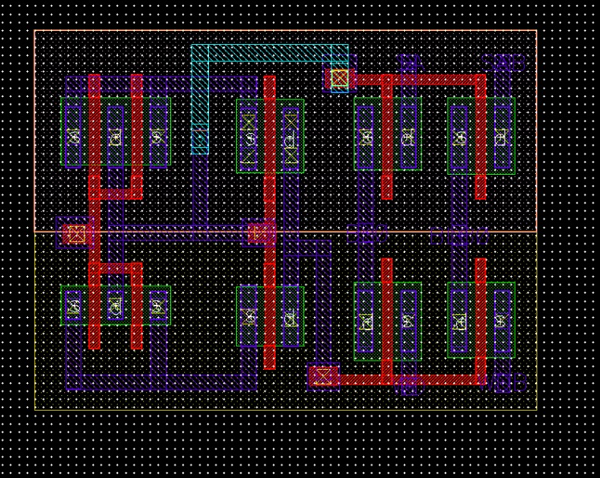
Column Decoder Layout
2X4 Decoder
Bitline Selection Box

Slide 16
Challenges,Future Plan And Work Distribution
.
Challenges:
We had difficulty deciding the correct sizing of the column decoder and had to try multiple times.
We faced issues like LUP/dup DRC errors and sconnect problems, which made debugging and fixing the layout difficult.
We also faced difficulty in area optimization while using fingers in both the predecoder and column predecoder.
Future Plans:
Minimize layout areas to improve efficiency.
Focus on reducing delays for predecoder.
Aim to optimize PPA (Power,Performance,Area)
Work Distributions:
All three members were equally involved in all aspects of the work.

Slide 17
THANK YOU!

